Slide 1


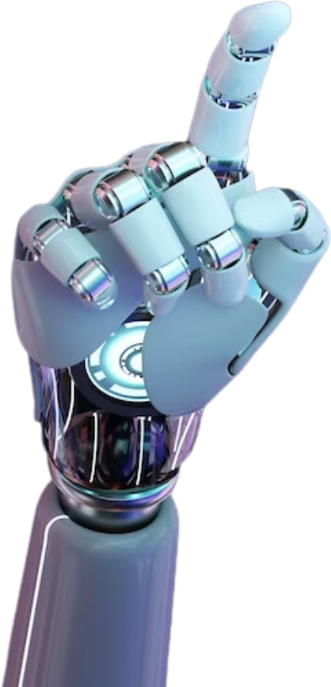
TEAM LOCOMAKERS
2025
MINT HACKATHON
Vigilant Drive
AI that guards every mile!
Theme
AI FOR SAFE AND SUSTAINABLE MOBILITY

Slide 2
TEAM LOCOMAKERS.
Problem Statement
Fatigue and distraction contribute to 20–25% of global road accidents, yet most vehicles lack real-time monitoring systems. Current solutions are reactive rather than preventive, leaving drivers and transport ecosystems at risk. Addressing this challenge is crucial for safer and more sustainable mobility.
Next Slide
WHERE INNOVATION MEETS OPPORTUNITY.

Slide 3
TEAM LOCOMAKERS.
Proposed Solution
VigilantDrive is an AI-powered driver monitoring system that detects drowsiness and distraction in real time using facial landmark tracking and deep learning. The system continuously analyzes eye closure, yawning, and head movements through a camera feed. When signs of fatigue are detected, it triggers visual and auditory alerts to refocus driver attention and prevent accidents.
  AI-Driven Detection: Uses CNN-based facial analysis and OpenCV for accurate fatigue and distraction recognition.
  Proactive Safety Mechanism: Provides early alerts before accidents occur — not just after driver failure.
  Lightweight & Real-Time: Works efficiently on embedded systems or dashboards without internet dependency.
  Scalable for All Vehicles: Adaptable for personal, public, and commercial transport fleets.

Slide 4
TEAM LOCOMAKERS.
Real World Impact
  Enhanced Safety: Early detection prevents up to 25% of fatigue-related crashes, protecting drivers and pedestrians.
  Sustainable Mobility: Fewer accidents reduce traffic congestion, fuel waste, and carbon emissions.
  Economic Efficiency: Lowers costs for logistics firms, insurers, and public agencies by minimizing road incidents.
  Social Inclusion: Promotes safe working conditions for professional drivers and supports accessible urban mobility for all.

Slide 5
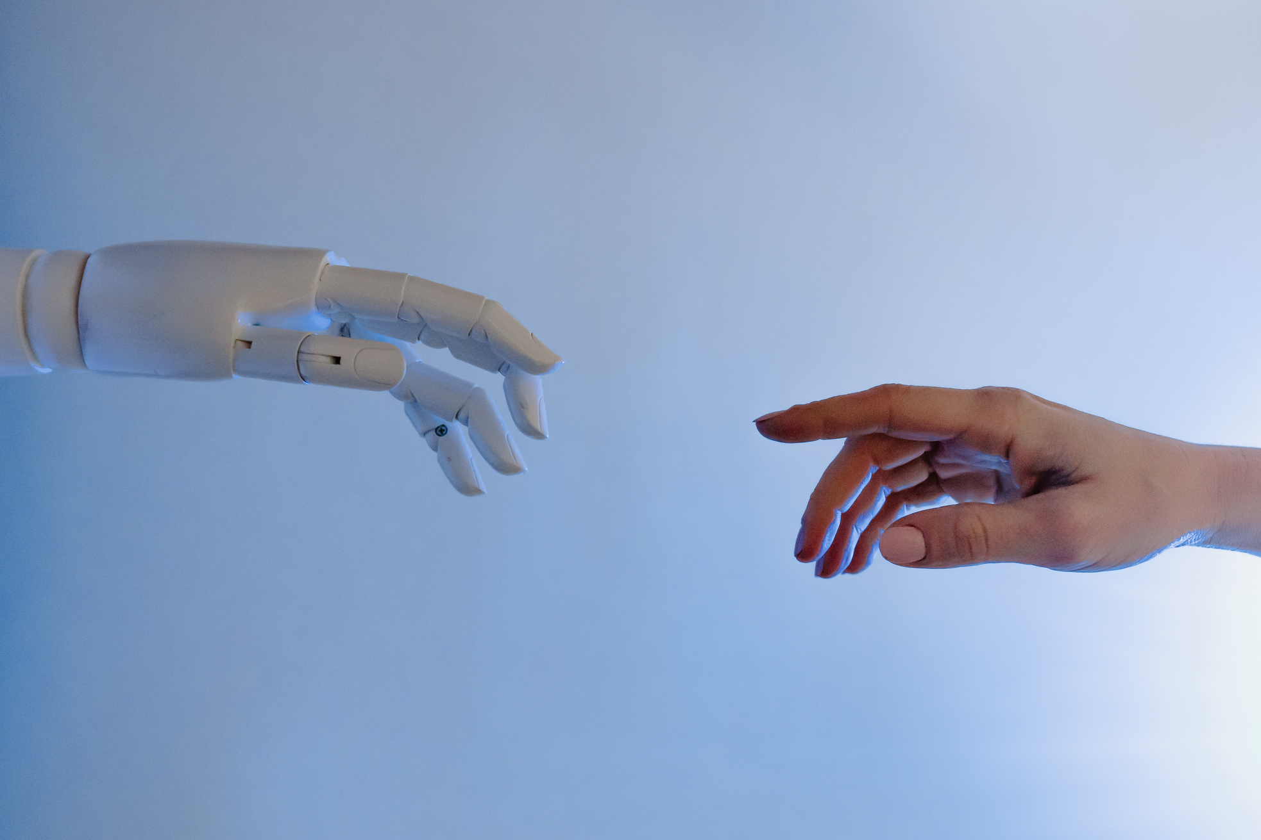
TEAM LOCOMAKERS.
Stakeholders & Beneficiaries
  Individual Drivers: Gain real-time safety assistance during long or late-night drives.
  Transport & Logistics Companies: Improve operational reliability and driver welfare.
  Government & Smart City Programs: Integrate VigilantDrive into Intelligent Transport Systems (ITS) to support safer, data-driven road management.
  Public & Communities: Benefit from safer roads, reduced emissions, and fewer disruptions.

Slide 6
TEAM LOCOMAKERS.
Tech Stack
  CNN (Deep Learning): Detects eye closure, yawning, and head tilt.
  OpenCV + Dlib: Real-time face and eye landmark tracking.
  Alert Module: Visual + buzzer alerts to regain attention.
  TensorFlow Lite: Lightweight, fast, and edge-device compatible.
  Python Stack: NumPy, SciPy, Imutils for data processing.
Feasibility
  Prototype testing confirms that the model achieves over 90% accuracy at 30 FPS, demonstrating that real-time drowsiness detection is practically achievable and scalable on affordable systems.
  Built using readily available AI tools and low-cost hardware, VigilantDrive is not just a concept — it’s a deployable reality.

Slide 7
TEAM LOCOMAKERS.
Working
1.Camera Captures Driver’s Face
    Real-time video feed from a webcam or dashboard camera.
    Works in varied lighting and motion conditions.
2.Facial Landmark Detection
    Uses MediaPipe / Dlib to track eyes, head tilt, and yawning.
    Generates key facial points for fatigue/distraction analysis.
3.AI-Based Drowsiness & Distraction Analysis
    CNN Model evaluates eye closure, blink rate, and head posture.
    Predicts risk of drowsiness or distraction in real time.
4.Alert Mechanism
    Visual Alert: Red overlay on screen.
    Auditory Alert: Buzzer or alarm to immediately refocus driver attention.
5.Optional Data Logging & Analytics
    Records drowsiness events for fleet management or driver behavior analysis.

Slide 8
TEAM LOCOMAKERS.
SWOT
ANALYSIS
Strengths
Weeknesses
REAL-TIME AI
LOW-COST
SCALABLE
PROACTIVE
CAMERA-DEPENDENT
CALIBRATION NEEDED
VISUAL-ONLY
ALERT SENSITIVITY
Oppourtunities
Threats
ADAS INTEGRATION
FLEET EXPANSION
SDG ALIGNMENT
DATA INSIGHTS
COMPETITORS
LOW ADOPTION
MALFUNCTIONS
PRIVACY CONCERNS

Slide 9
TEAM LOCOMAKERS.
Working Prototype
Watch VigilantDrive in action – detecting driver drowsiness in real time.
Click the link to see alerts and proactive safety measures in action
Link:
Vigilant Drive Working Video
-

Slide 10

TEAM LOCOMAKERS.
Thank You
Stay Alert. Save Lives. Every Mile Counts.
TEAM LOCOMAKERS

Slide 11
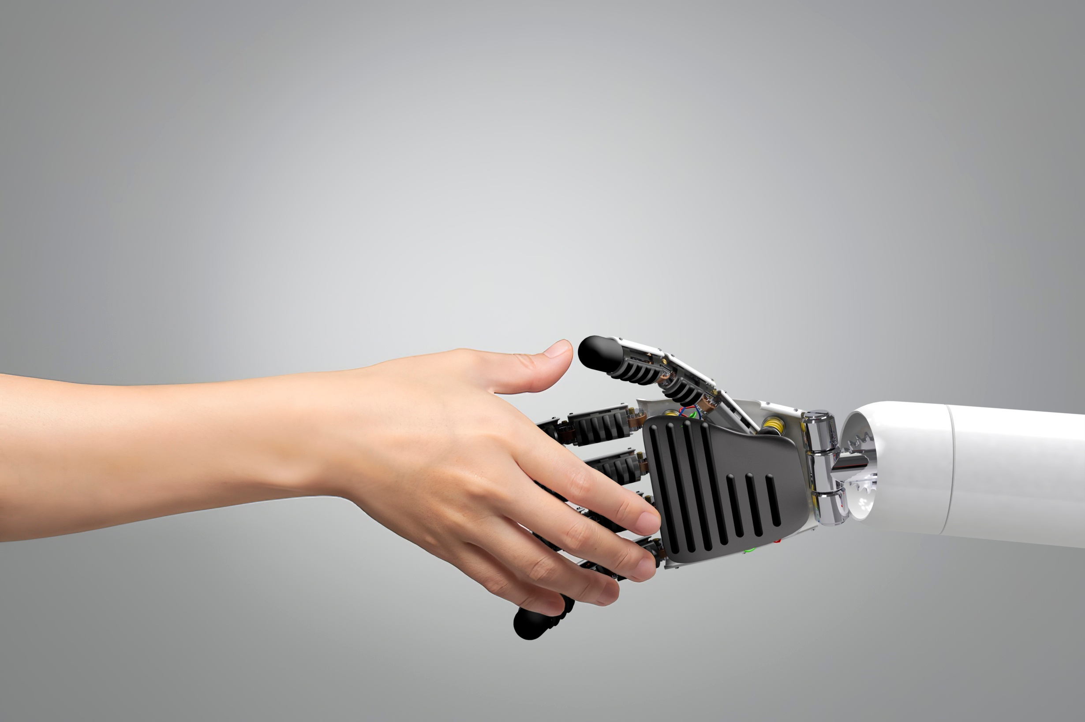
THYNK UNLIMITED.
HOME
ABOUT
CONTENT
OTHERS
AI in Decision-
AI-powered analytics tools are helping executives and managers make faster, more accurate decisions. Predictive modeling and real-time dashboards are becoming essential in identifying market shifts, customer behaviors, and operational bottlenecks.
Making

